Slide 1

Strategic Decision Making with Power BI
Group - 3

Slide 2
Problem Statement
"Unlocking Olympic performance trends to empower businesses with data-driven insights for sponsorship, marketing, and audience engagement in the sports and entertainment industries."
Background
The Olympic Games are more than just a global sporting event—they are a goldmine of data that reflects trends in country-wise dominance, athlete success, and sports popularity. This data is invaluable for businesses in sportswear, broadcasting, advertising, and event management, offering unique opportunities to align with top-performing athletes, target audience demographics, and create impactful marketing campaigns. By analyzing historical performance and demographic trends, businesses can unlock new growth avenues, optimize their strategies, and connect with audiences on a deeper level.

Slide 3
Objectives
Identify top-performing countries, sports, and athletes for sponsorship opportunities.
Leverage age, gender, and seasonal trends to craft targeted marketing strategies.
Prioritize popular sports and events to boost audience engagement.
Use historical trends to guide data-driven business decisions.
Align brand campaigns with successful athletes and medal-winning sports.

Slide 4
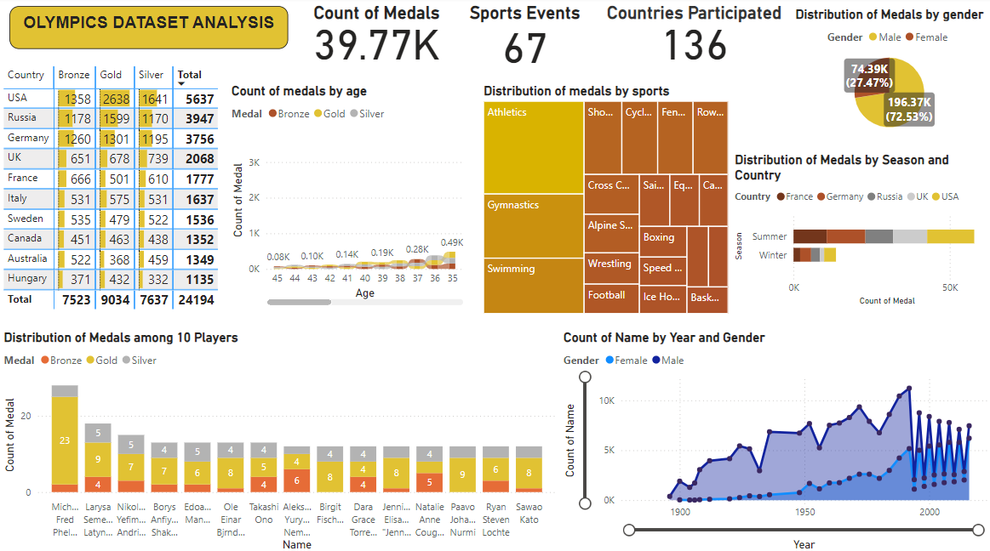
Dashboard
Link: https://ifimbschool-my.sharepoint.com/:u:/g/personal/amartya_majumder2325_jagsom_edu_in/EVb_CEVFueRKougTX5ifRc8B3Q77Ty9B_emZCGyWT0CWUQ?e=YEfzir

Slide 5
Analysis
KPIs at the Top:
Total Medals: Shows the total medals won (39.77K).
Sports Events: Number of sports events included (67).
Countries Participated: Total number of countries that participated (136).
Univariate Analysis:
Distribution of Medals by Gender:
Pie chart shows male athletes have won 72.53% of the medals.
Medals by Country:
A table summarizes the medal tally for top-performing countries like the USA, Russia, and Germany.
Medals by Age:
Line graph indicates the count of medals won across different age ranges of athletes.

Slide 6
Analysis
Multivariate Analysis:
Medals Over Time by Gender:
Line graph indicates how the count of medals has evolved over the years, with gender differentiation.
Top Players' Medal Distribution:
Horizontal stacked bar chart highlights the number of medals won by the top 10 players and their respective medal types (Gold, Silver, Bronze).
Bivariate Analysis:
Medals by Sports:
Treemap shows the distribution of medals across sports such as athletics, gymnastics, swimming, etc.
Seasonal Performance by Country:
Stacked bar chart visualizes how medals are distributed between summer and winter Olympics for countries.

Slide 7
Key Insights
Top Performing Countries:
The USA has won the most medals historically, with 2,500+ medals (1,000+ golds).
China’s medal tally has grown by 15% per Olympic cycle since 2000.
Sports Popularity:
Athletics accounts for 25% of total medals, followed by swimming at 18%.
Gymnastics saw a 10% growth in medals won by emerging nations over the last 3 Olympics.
Gender Trends:
Female athletes have contributed to 45% of total medals, up from 30% in the 1970s.
Mixed-gender events introduced in 2020 contributed to 5% of total medals.

Slide 8
Key Insights
Seasonal Analysis:
Summer Olympics account for 70% of total medals, while Winter Olympics contribute 30%.
Countries like Norway and Canada dominate the Winter Olympics, collectively winning 40% of winter medals.
Age Distribution of Medalists:
The average age of medal winners is 26 years, with a range of 18–35 years for most sports.
Younger athletes (18-22 years) won 30% of swimming medals, while older athletes (30+ years) dominated shooting with 40% of medals.
Historical Trends:
Medal counts have increased by 20% since 1980 due to the inclusion of new events and countries.
Emerging nations like India have improved their medal tally by 300% since 2000.
Athlete Dominance:
Michael Phelps holds the record for the most medals by an individual, with 28 medals (23 golds).
Top 10 athletes account for 5% of all gold medals won historically.

Slide 9
Recommendation
Partner with Top Performers: Sponsor medal-dominant countries like the USA and China and focus on high-visibility sports like athletics and swimming.
Target Demographics: Create inclusive campaigns for female athletes (45% of medals) and age-specific messaging for young and veteran athletes excelling in key sports.
Tap Emerging Trends: Focus on growing markets like India (300% medal growth) and promote mixed-gender events (5% of medals) for innovative outreach.

Slide 10
Conclusion
The Olympic performance dashboard provides actionable insights into trends across countries, sports, gender, and athlete demographics. These insights enable businesses in sportswear, broadcasting, and sponsorship industries to align their strategies with data-driven opportunities.
Key takeaways include:
Leveraging consistent performers like the USA and China for sponsorships.
Targeting high-growth sports and inclusive demographics to maximize marketing impact.
Capitalizing on audience interest in high-viewership events like athletics and gymnastics for greater engagement.

Slide 11
Thank You

